Slide 1
AIA Data Exploration
Mildred Vanessa Epui

Slide 2


Agenda
A
Introduction
Process Flow
List of Assumptions
Challenges
Insights on Agent Behaviour
Answer Submission
Closing & Thank You

Slide 3
Introduction
This presentation is to present the findings from the data.

Slide 4
Process Flow for Codes
Deploy model
1. Load Files
1. Load and merge the files
- AGENT.csv ( take only Inforce and Agency
-MAIN.csv
- Support (B,C,D,E.csv)
2. Merge according to requirements
Incorporate SQL logic
3. Pre-processing and EDA
1. Iterative Process
2. Preprocessing to acquire CAT 1, CAT 2, and CAT 3.
3. Present insights and findings
1. Feature engineer combinations of Purpose_code and CAT 1,2,3 to get more information.
2. Recommender system for best value policy or best combination policy.
5. Results
4. Clustering/Classification

Slide 5
Challenges
List of Challenges faced during assessment and how they will affect the results

Slide 6
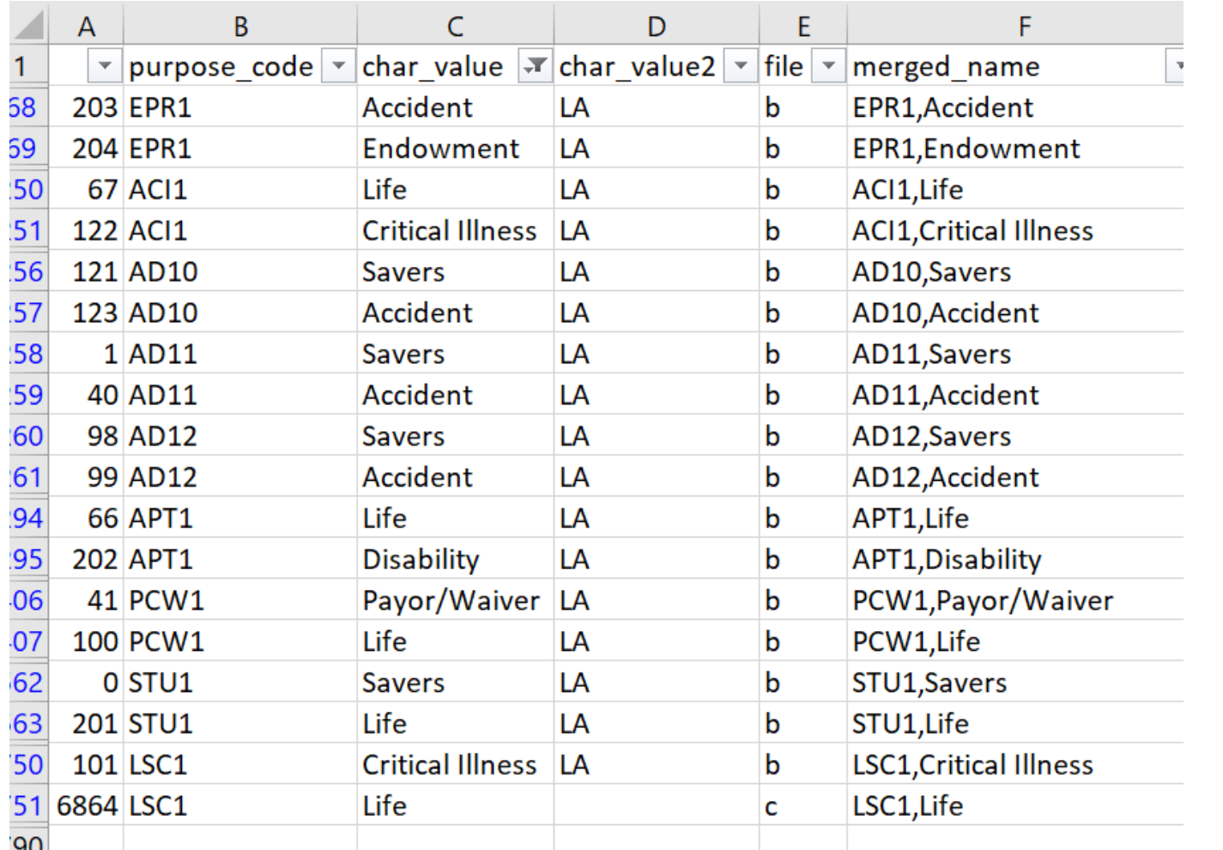
Data Challenges
Purpose Code is not unique
1
The only way to merge main and support files is to merge by a unique identifier, which in our case is Purpose Code. If the Purpose code contains duplicates, then the main data will increase in rows.
I am also not able to join by s_base and char_value2 because char_value2 is mostly missing (97.1%).
I am not able to just remove duplicated purpose code because in char_value (picture above or refer to df_duplicate_pcode3.csv), most of the duplicates are due to Other Medical and Medical (Which was required to change in SQL logic.)
There are also other different types of char_value with duplicated purpose code.

Slide 7
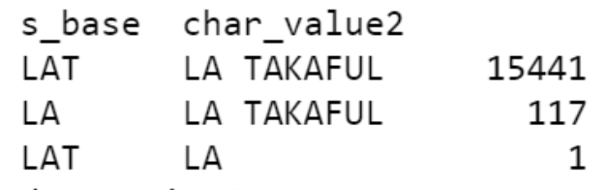
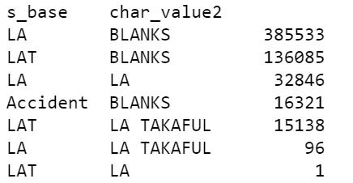
Data Challenges
Unable to Differentiate LA, LAT, LA TAKAFUL
2
Based on initial findings, I found that s_base and char_value2 are conflicting.
The above only adds up to 15,559, which is much lower than our original Main Data rows of 495,854. It's because char_value has blanks. After filling the blanks, this is how what we have.
Here we cannot assume s_base or char_value2 is correct, as we need to find out how the data is populated.
Business To-Do: To determine root cause of LA, LAT, LA TAKAFUL and standardize the name.
It's causing duplicate problems, which will affect our data preprocessing.
Point to ponder: IF this value is populated by agents, does it mean that agents are unaware of the definition of LA, LAT, and LA TAKAFUL?

Slide 8
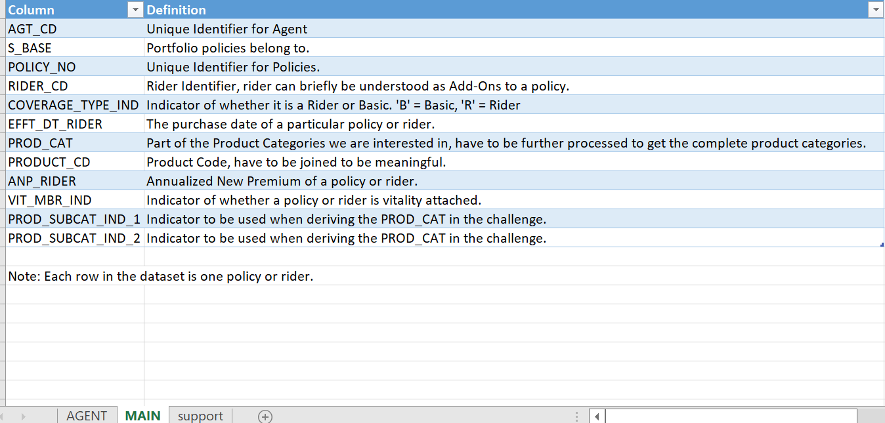
Data Challenges
Purchase_dt is not defined whether it is purchase date or effective date
3
In data_dictionary, there is no definition for Purchase_dt. However, there is definition for EFFT_DT_RIDER, which is purchase date of a particular policy or rider.
In data received, the range of the Purchase_dt is 1/1/2019 to 31/7/2030.
If the definition in data_dictionary is for Purchase_dt, it does not make sense for a purchase to have been done in 2030.

Slide 9
List of Assumptions
List of assumptions made

Slide 10
Assumptions
Support files must have unique purpose code when combined, in order to be able to merge with Main data.
LA, LAT, and LA TAKAFUL are the same.
If different char_value contains the same purpose code, it must be dropped. However this will cause incorrect reporting of data.
Purchase_dt is date of purchase.

Slide 11
Summary
Due to data challenges, it is NOT recommended to proceed without clarification of the challenges by Business.
The next section will be continued by only combining MAIN.csv and AGENT.csv. Support files are NOT combined into the working file.

Slide 12
Answer Submission
My answers to the questions posed in ds_assessment.pdf

Slide 13
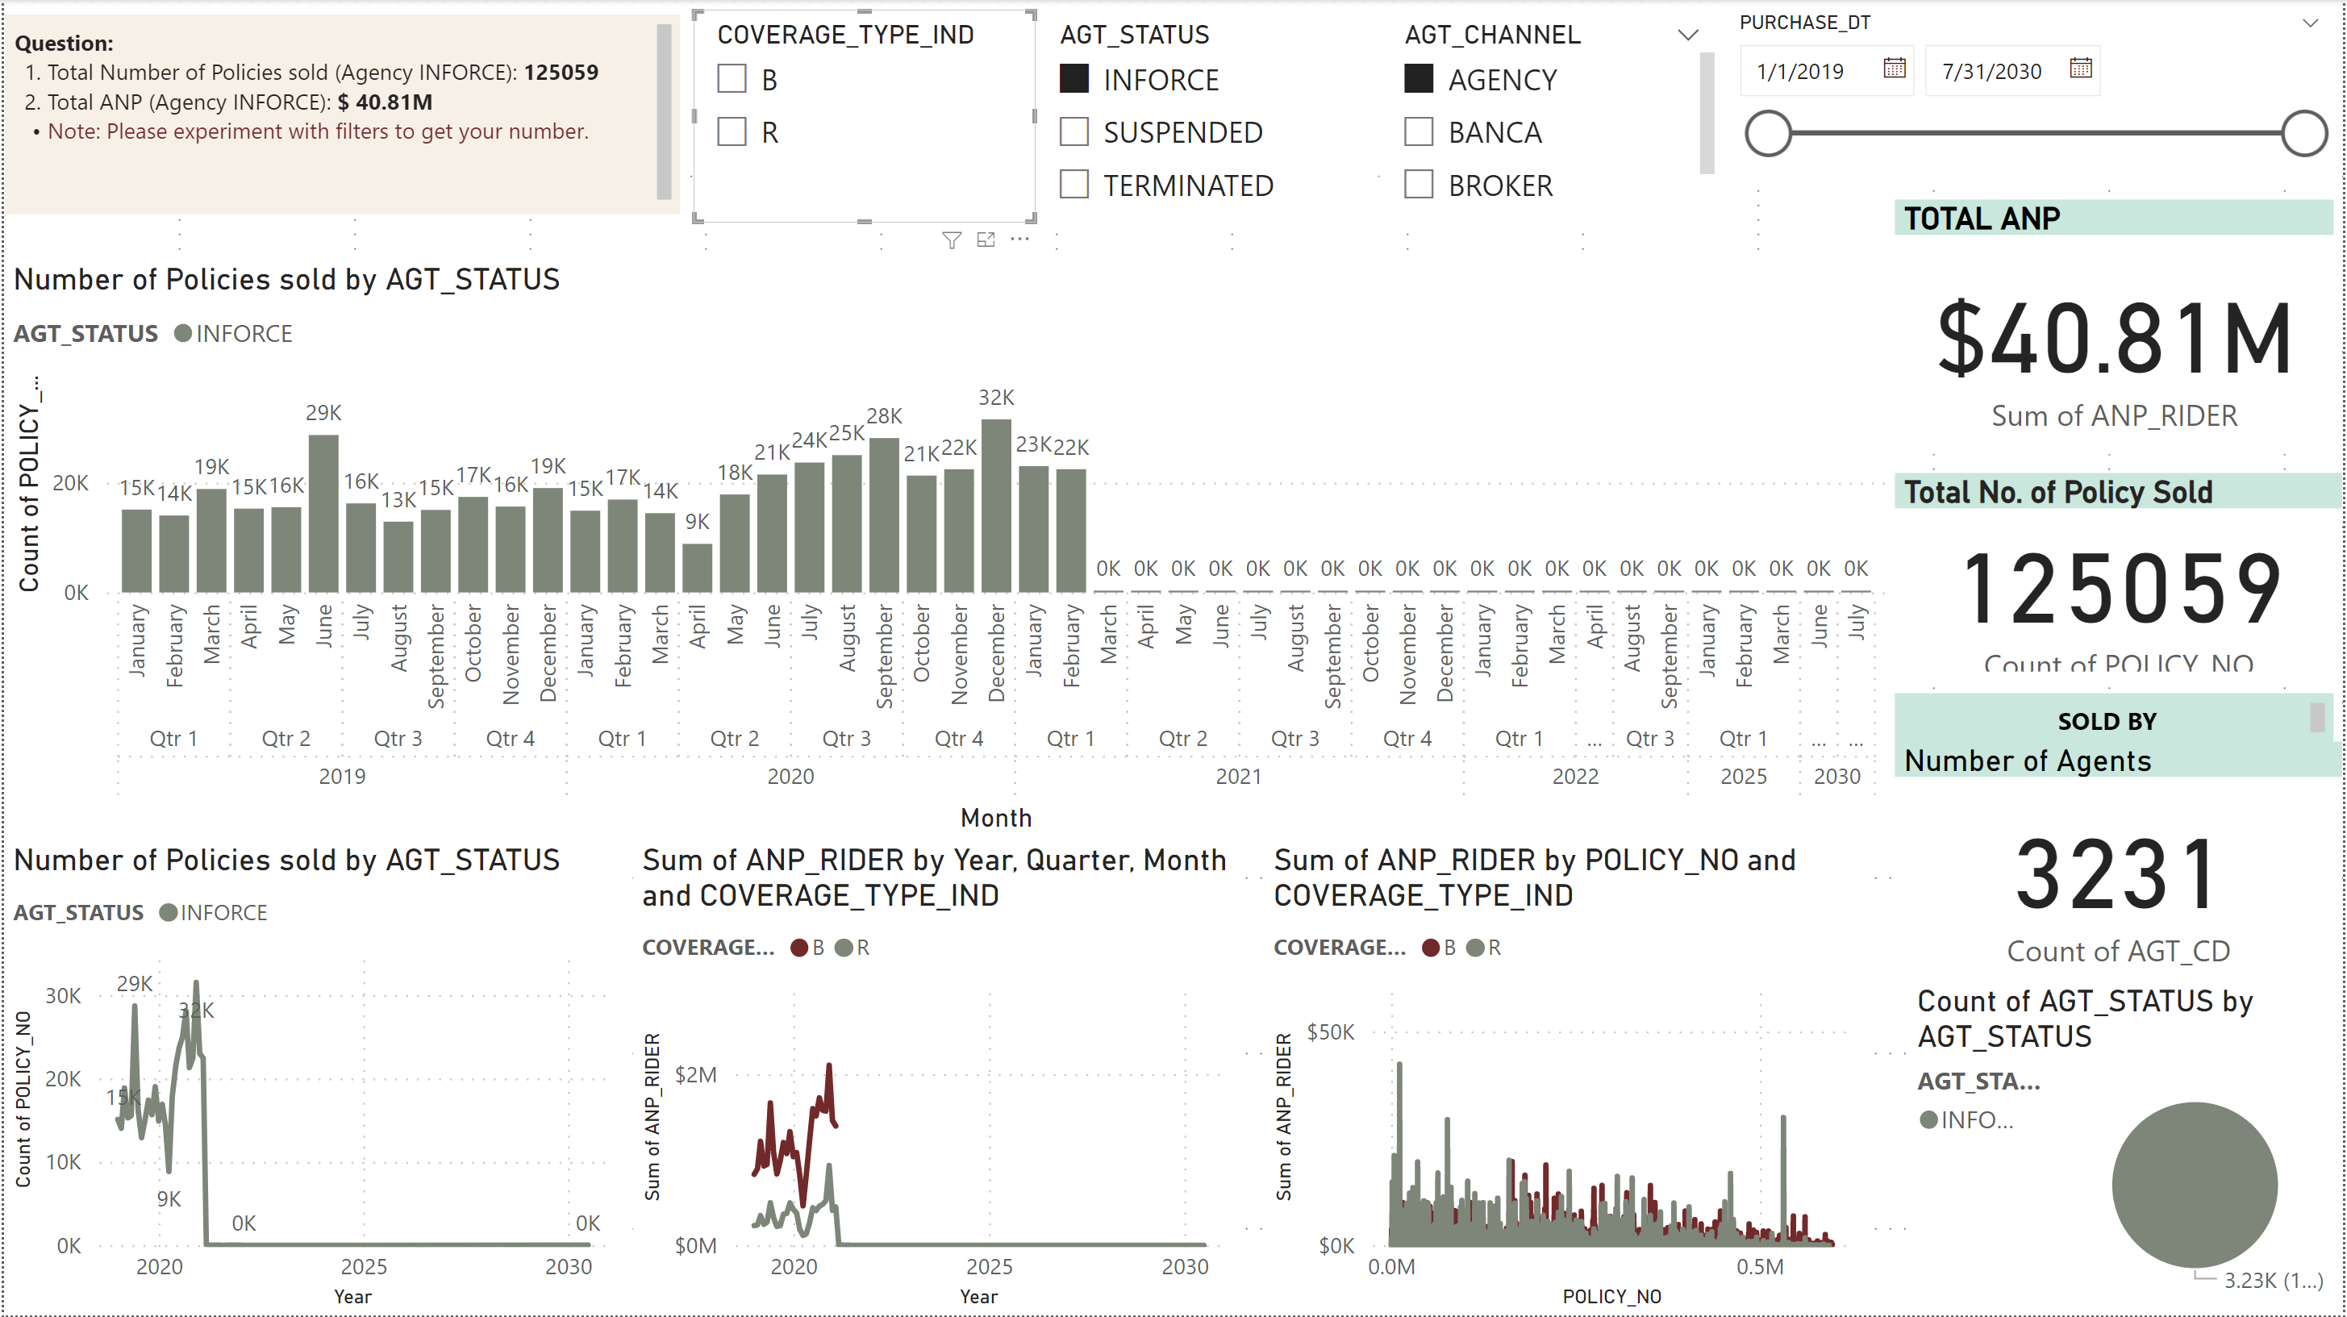
Total Number of Policies sold : 125059

Slide 14
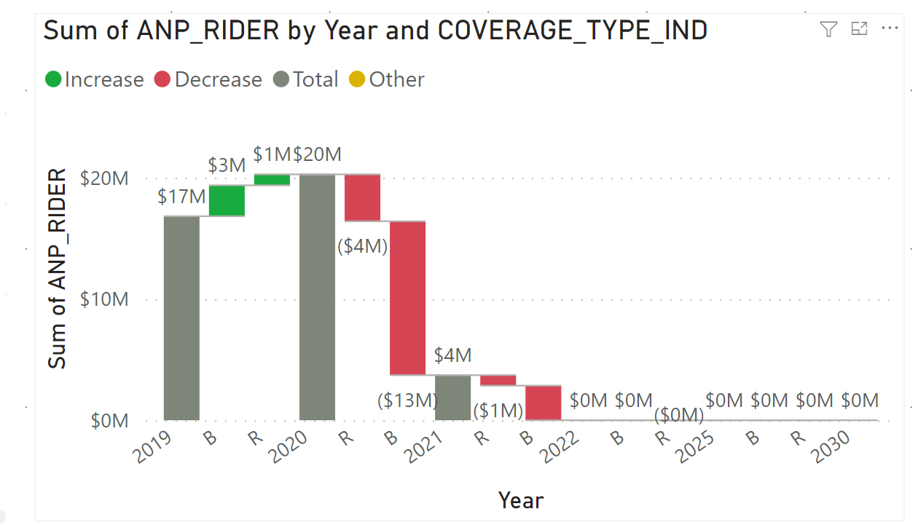
Total Annualized Net Premium from 2019 onwards: $ 40.81Million
Note:
Annualized New Premium is the total ANP_Rider from 2019 onwards.
Due to purchase_dt challenges, the ANP per year shown below is not accurate.

Slide 15
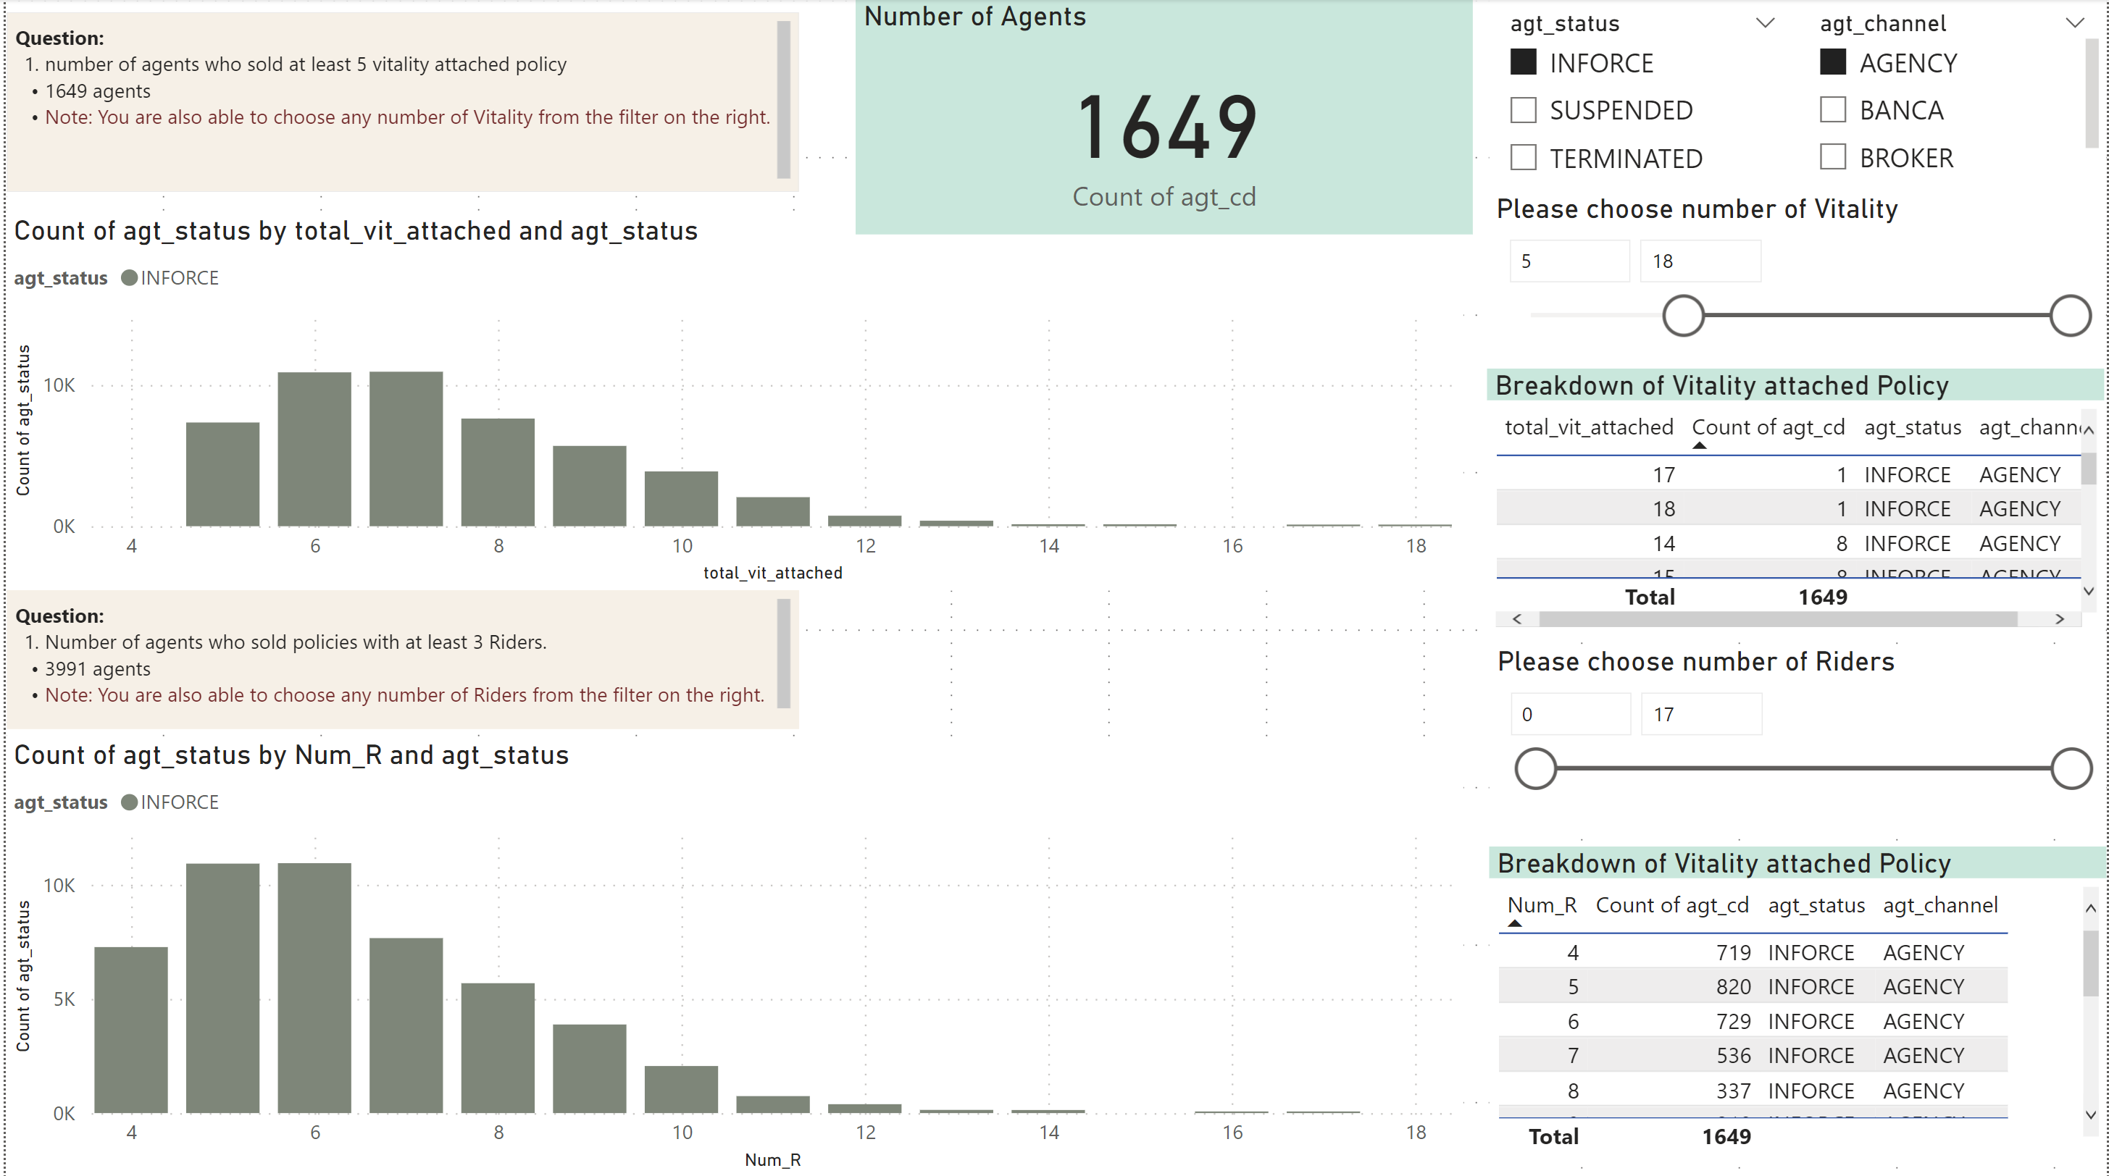
Number of Agents (INFORCE AGENCY) who sold at least 5 vitality attached policy: 1649

Slide 16
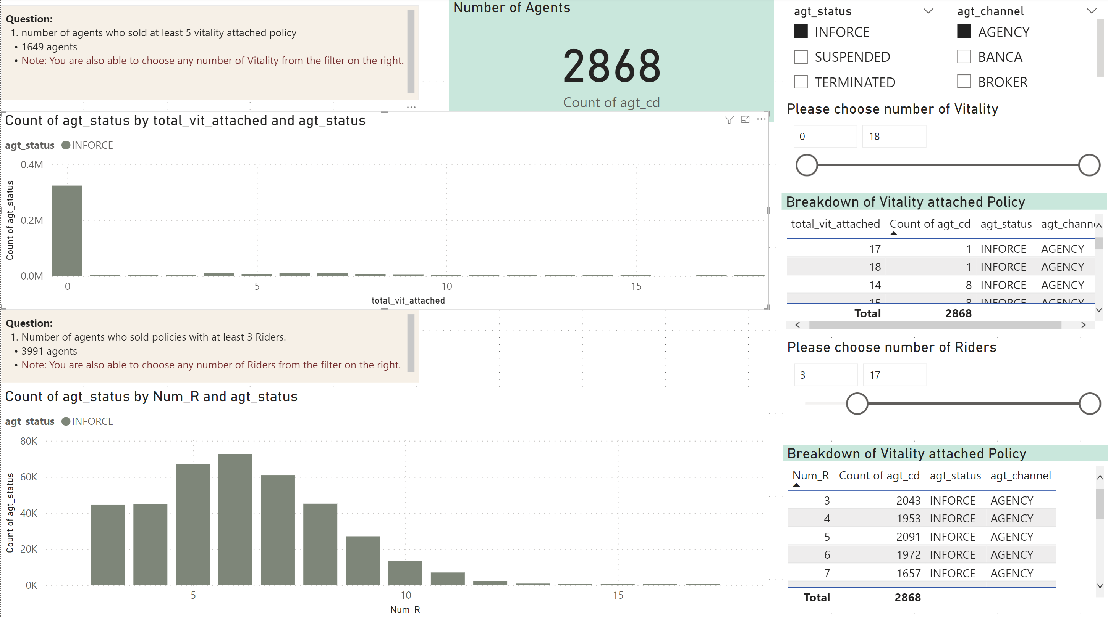
Number of Agents (INFORCE AGENCY) who sold policies with at least 3 Riders: 2868

Slide 17
Insights: Policies
Focusing only on Inforce and Agency

Slide 18
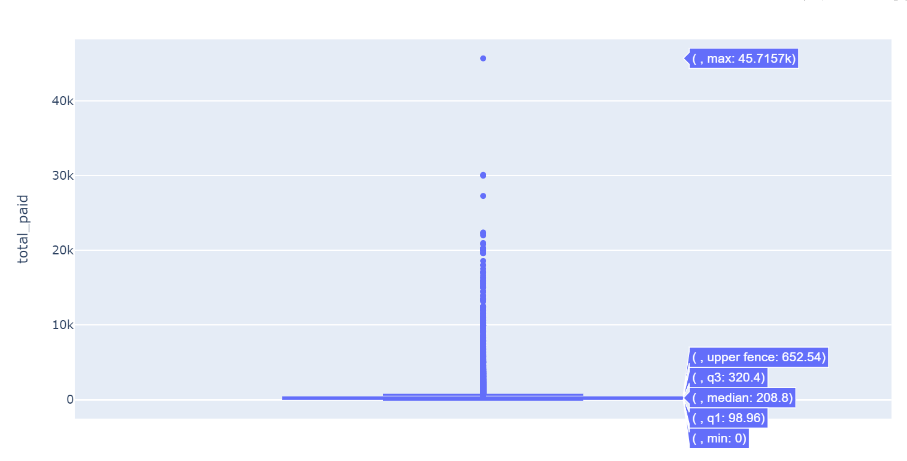
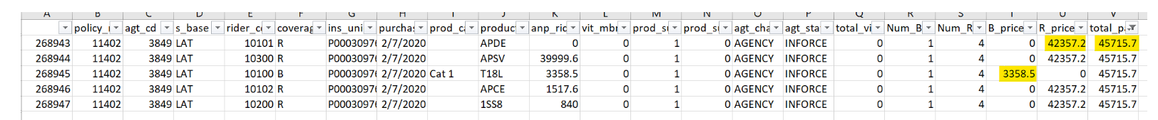
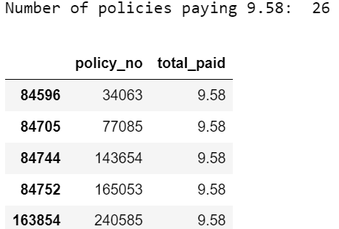
Min, Max, Median of Policy Prices
Based on the data distribution in the box plot:
There is a total of 125,047 policies in this data.
The upper outlier whisker is very long, suggesting that there are extreme values towards the higher price.
The Median is 208.8, suggesting that most of the policies are priced as such.
A policy price is considered an outlier if it is more than 652.54
The Maximum paid for 1 policy is 45,715.70, where the Basic is 3358.5 and the 4 Riders totalling to 42,357.20 Policy_no is 11402 with the breakdown below.
The Minimum paid for 1 policy is 0 (148 policies have 0 basic and 0 riders paid).
The next minimum amount is 9.58, where there are 26 policies paying this amount. .

Slide 19
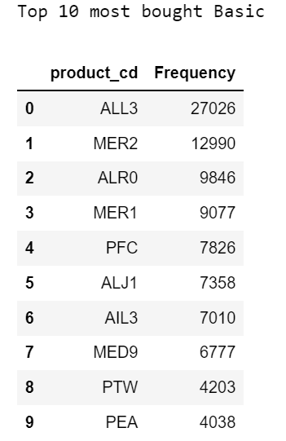
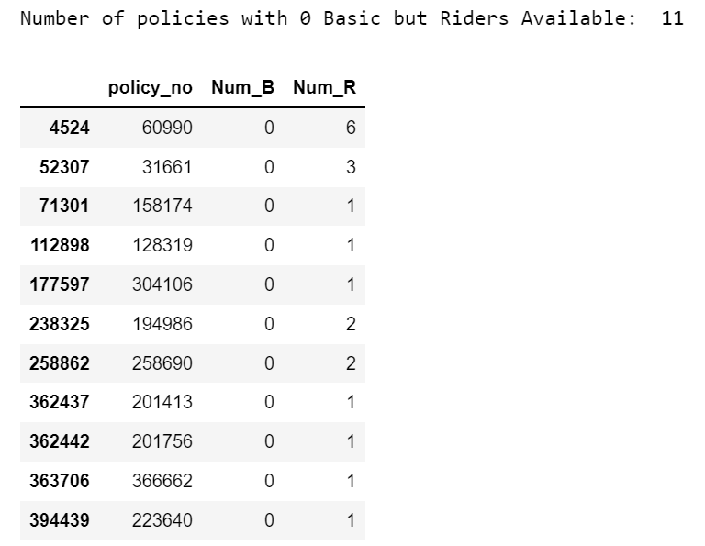
Distribution of Basic Policy
There is only 1 Basic to 1 Policy.
The below shows the top 10 Basic Product codes bought.
However, there are also 11 Policies without Basic but only have Riders.

Slide 20
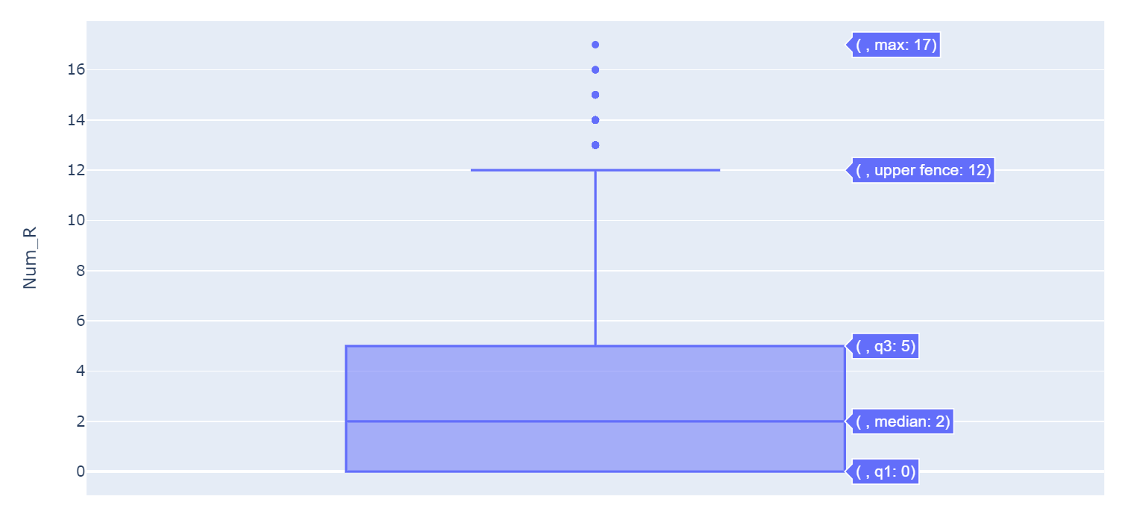
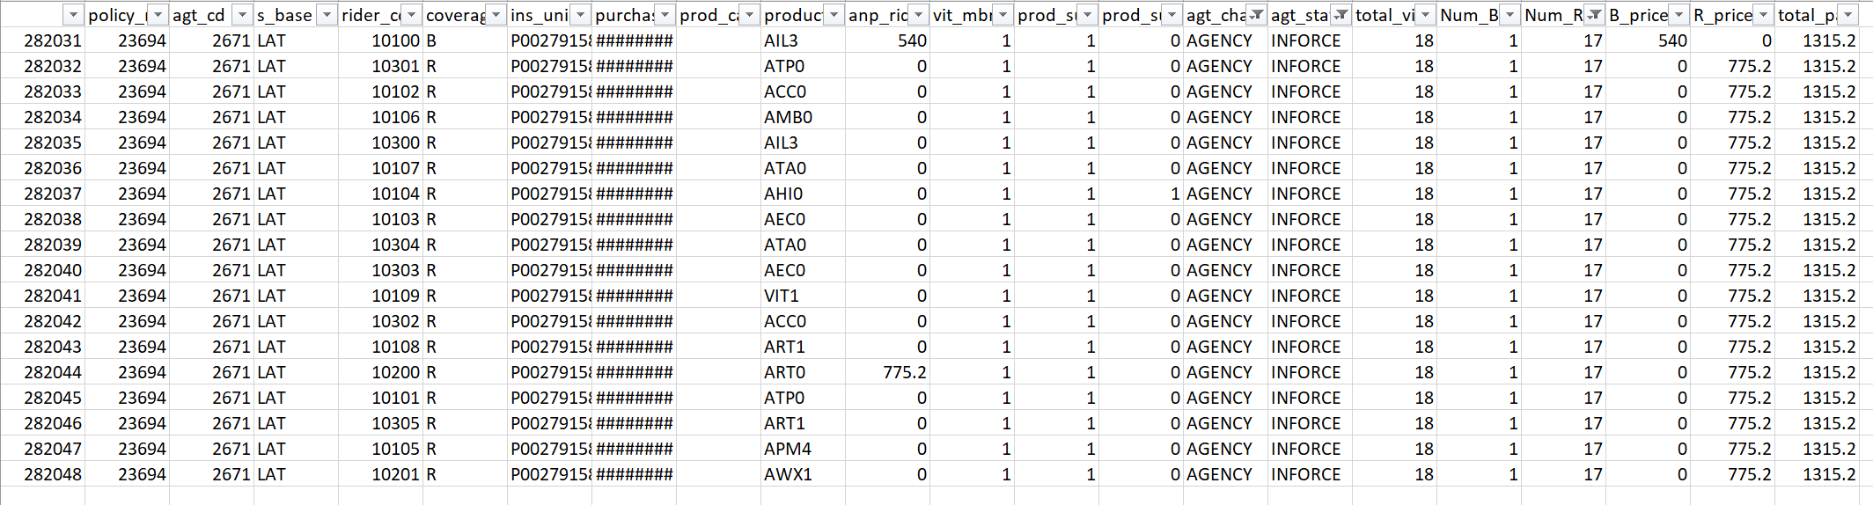
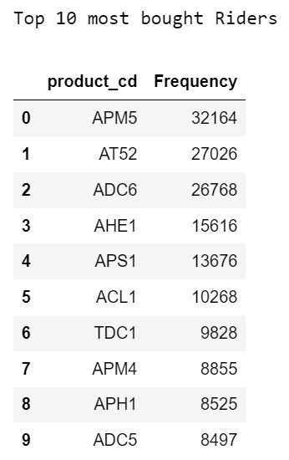
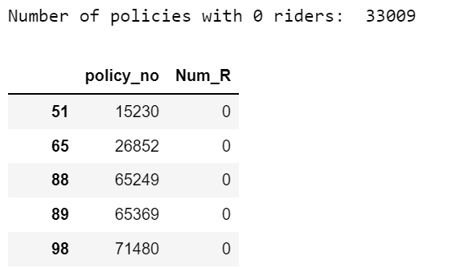
Distribution of Riders in a policy, and Rider combinations
There are 485 unique Rider Purpose Codes.
The Median is 2, suggesting that most of the policies have 2 riders.
A rider count is considered an outlier if it is more than 12.
The Maximum number of riders for 1 policy is 17 with the breakdown below.
The Minimum number of riders for 1 policy is 0, where we see 33009 policies as such.

Slide 21
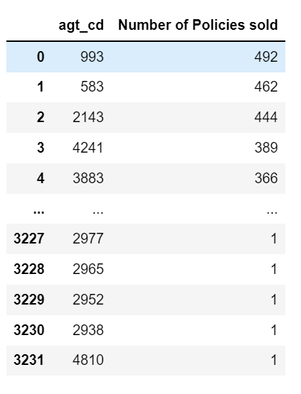
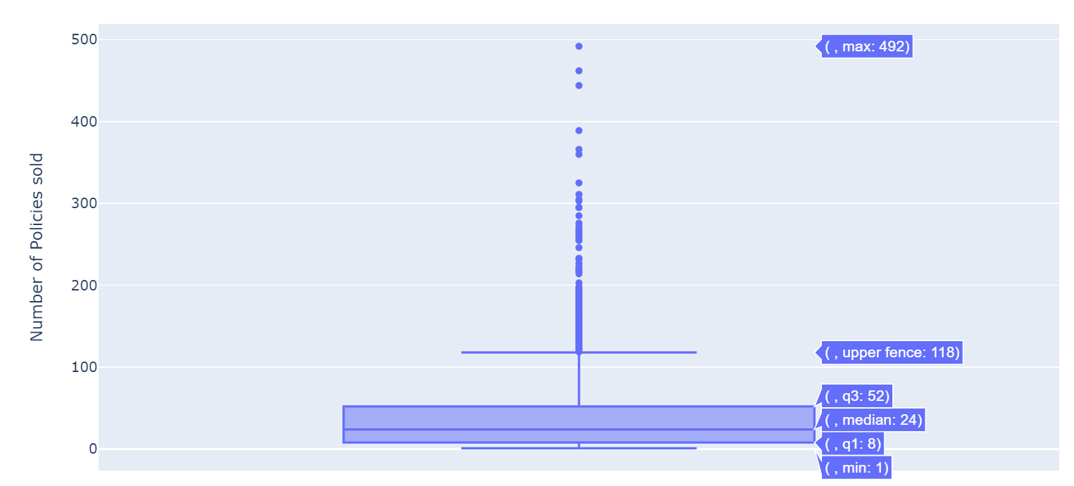
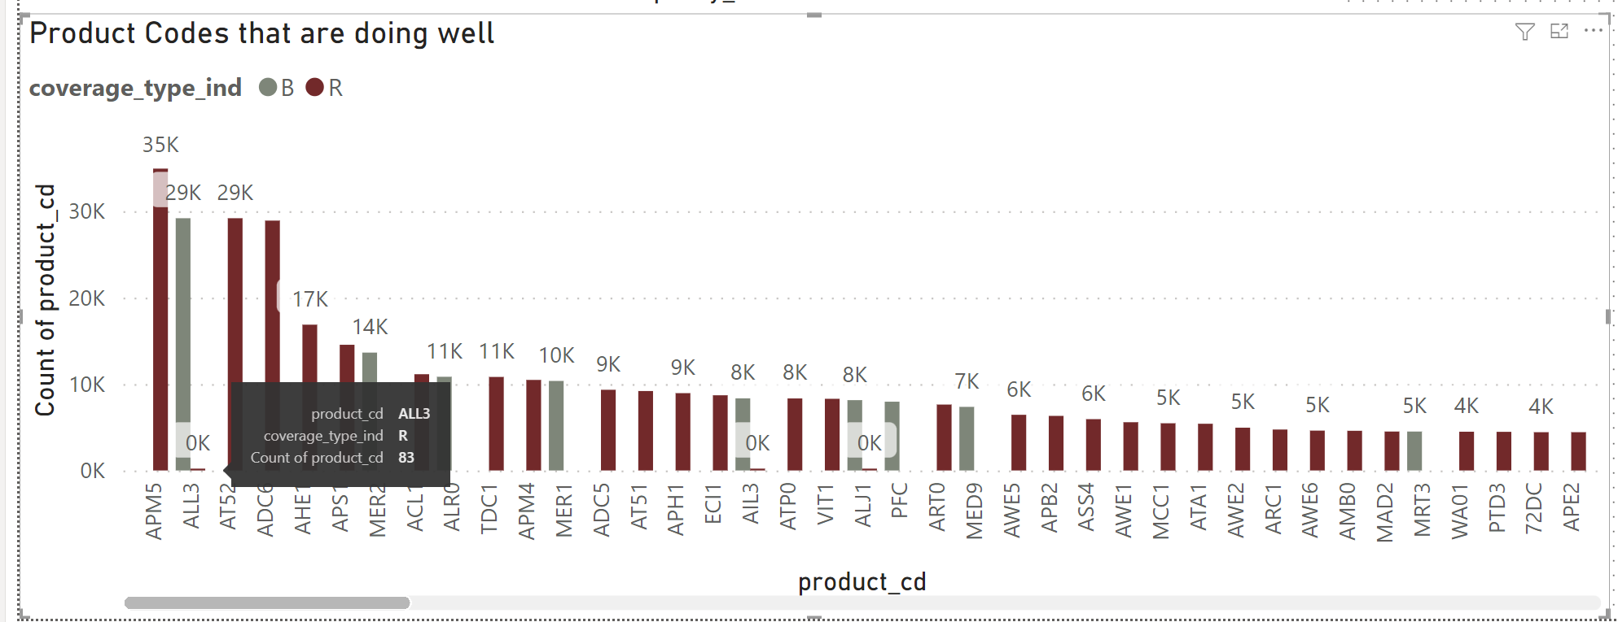
Distribution of Policies sold, and Policy Combination
Agent 993 sold the most policies (492).
The upper outlier whisker is very long, suggesting that there are extreme values towards the higher price.
The Median is 24, suggesting that most agents are selling this number of policies.
Number of Policy Sold is considered an outlier if it is more than 118.
From the below, it is shown that there are duplicates of product_cd.
Example: ALL3
There is 29,179 of ALL3 tagged as Basic. There are also 83 of ALL3 tagged as Rider. This situation can also be seen in AIL3, and ALJ1
This has caused a problem when merging Main with Support csv, causing duplicates in the data rows.

Slide 22
Closing and Thank you
Way forward Recommendations

Slide 23
Recommendations (let’s pretend this is a real project *wink*)
1. Agile Way or Working
R
Assuming that this is a project, daily standups between DS team and SME from business will help in clarifying data challenges, with bi-weekly sprint reviews to update on work progress.
This will also keep both Business and DS team up to date on the progress of the project.
2. Root Cause Analysis for Duplicate Values
By investigating how Purpose_cd and S_BASE (LA, LAT, LA TAKAFUL), are populated, we can target the root cause of the duplicates in those columns.
The solution can be customized to the problem (e.g. Retraining for Agents, standardization of product_codes)
3. Rules for a Policy to be considered good data.
There are Policies that do not have Basic, but only riders. There are also Policies where the total paid is 0.
Create rules and data pre-check to ensure that the Policy is considered as good data.

Slide 24
Thank you
Mildred Vanessa Epui
Mve.play@gmail.com

